Slide 1
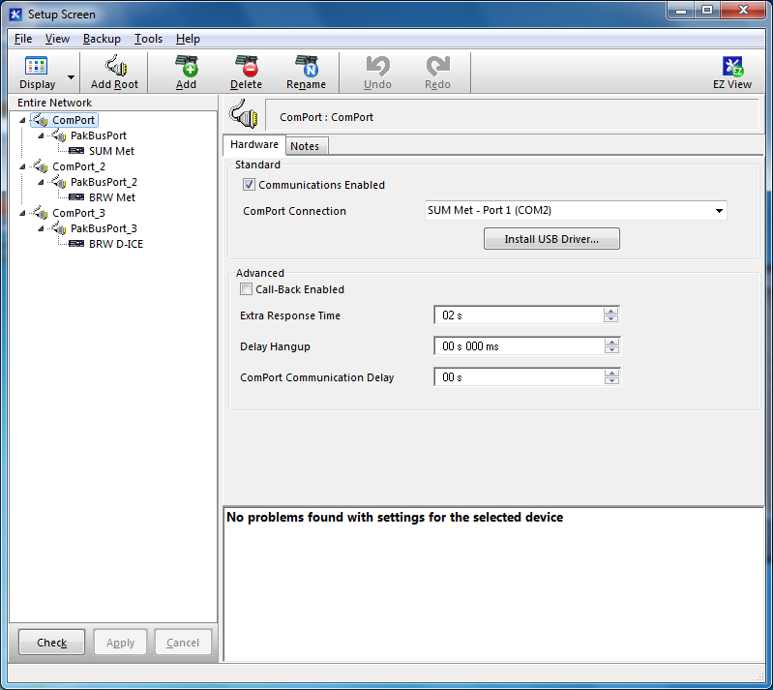
ComPort setup: First make sure the com port is set up in your computer (previous email - I’m guessing you’ll still be on COM5). You’ll then choose “PakBusPort” and ”CR1000”. For “Hardware”, you only need to check the “Communications Enabled” box.

Slide 2
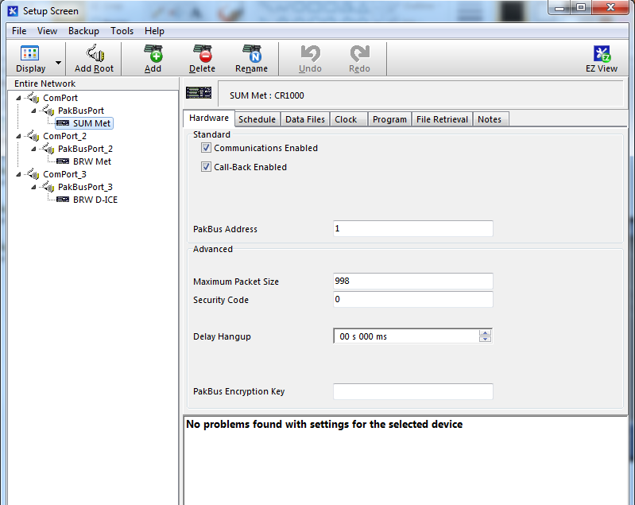
Once you’ve added the PakBusPort (no setting adjustments needed) and CR1000 (you can name it whatever you want), enable the communications (check box) under the ”Hardware” tab. No other adjustments needed.

Slide 3
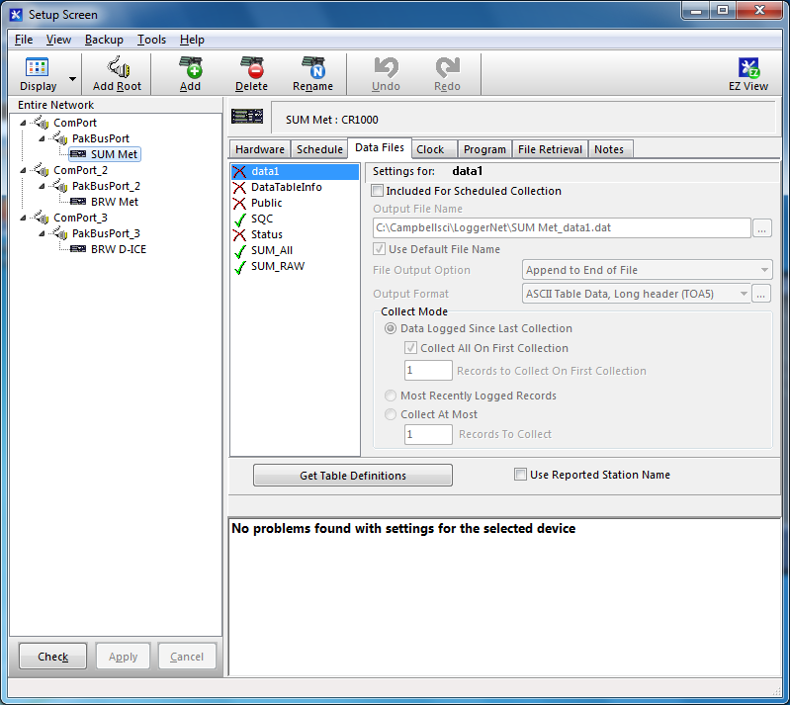
Don’t worry about schedule, unless you need to download the data every 15 minutes like we do (let’s just get you set up first, then we can think about data use and download). I’m pretty sure the “data files” tab is mostly for auto download, but only check the Sum_All file, just in case. This is the processed, human-readable data.

Slide 4
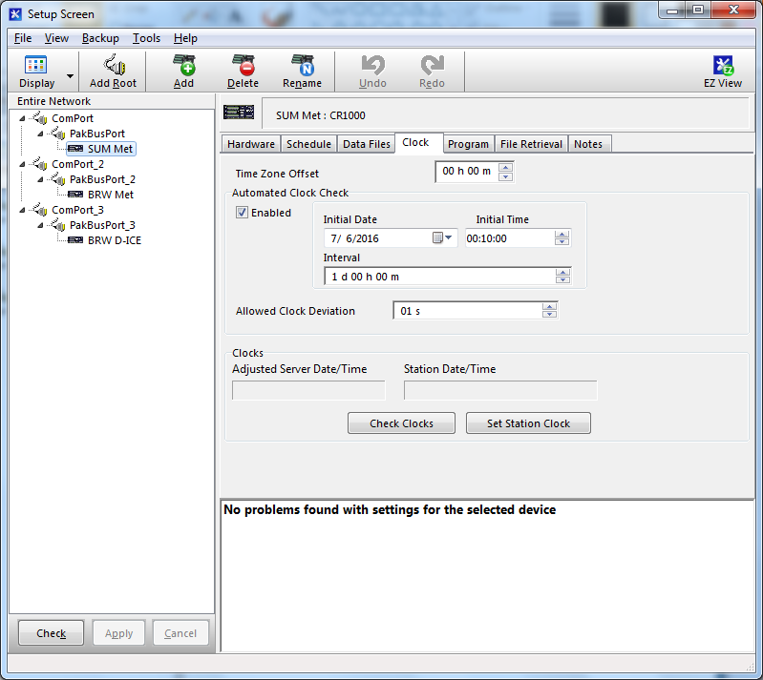
On this screen, please DISABLE the automated clock check (make sure the box is unchecked). We update the CR1000 clock daily from Boulder to keep it on track (so much better than the Zeno!).

