Slide 1


Summit weather Data
As a resource for operations
July 2008 – Oct 2016
Sam Dorsi

Slide 2
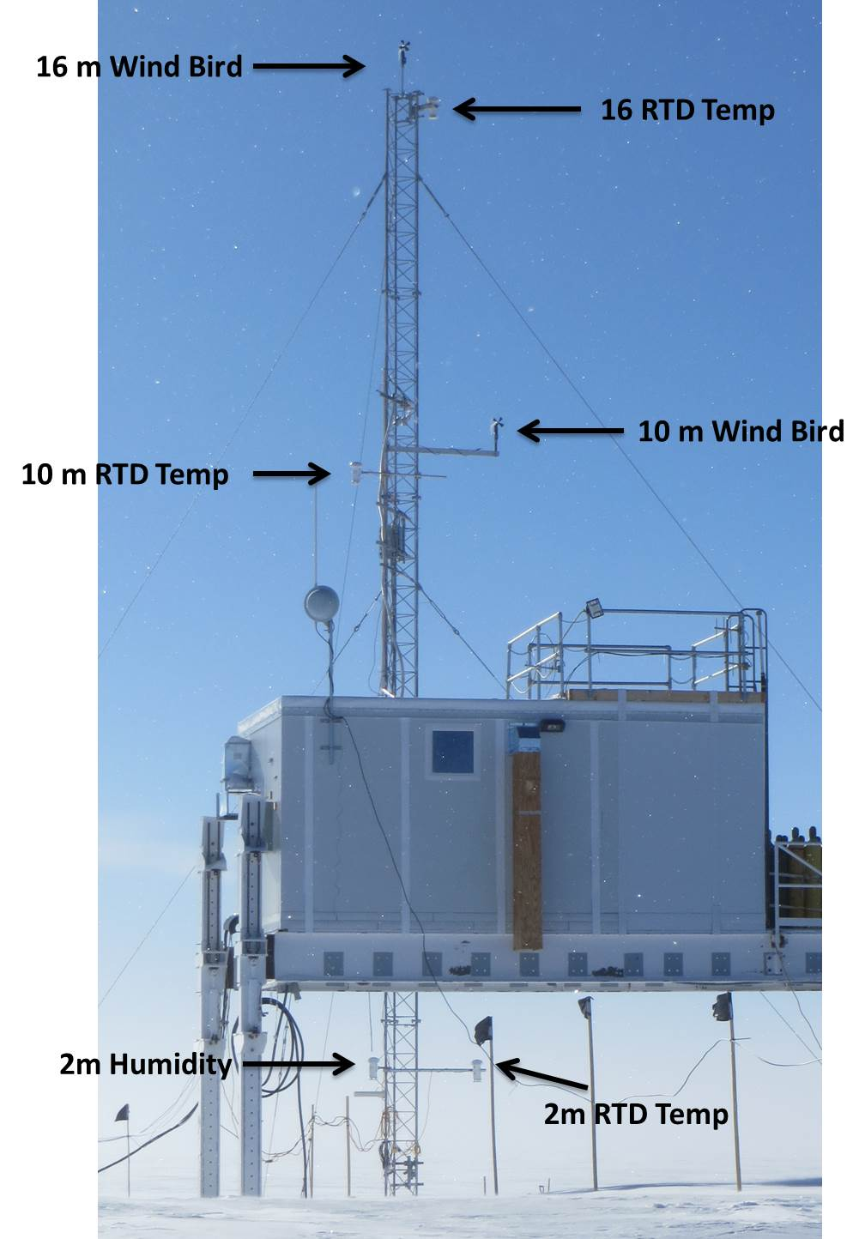
The data:
Source is NOAA - GMD
Wind speed and direction:
TAWO 10 m height
Air Temperature:
TAWO 2 m height
Using 1-minute data;
covers date range
July 2008 – Oct 2016

Slide 3

Major points:
Drifting winds come from the ESE, not the SSW.
North winds frequency peaks in July (31 %) and Aug (25 %)
Periodic drifting winds and equipment-stressing temps occur through through winter season.

Slide 4
Major points:
Drifting winds come from the ESE, not the SSW.
North winds frequency peaks in July (31 %) and Aug (25 %)
Periodic drifting winds and equipment-stressing temps occur through through winter season.

Slide 5
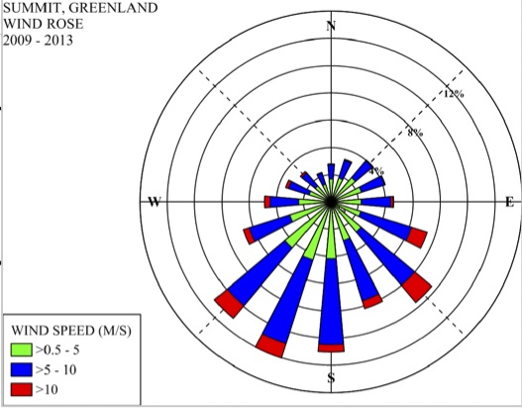
Here’s the ubiquitous Summit Station
wind rose from 2013.

Slide 6
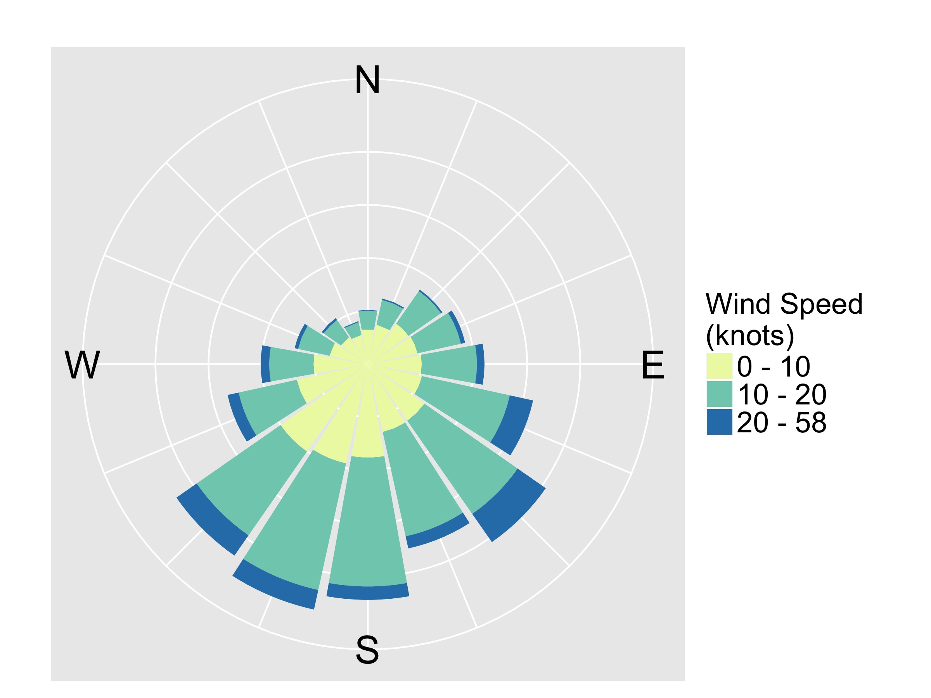
Here’s a similar wind rose, in knots,
using data through 2016.

Slide 7
As before, prevailing winds are
from the SSW.
But this chart mostly conveys information about low winds (< 20 kts).
SSW

Slide 8
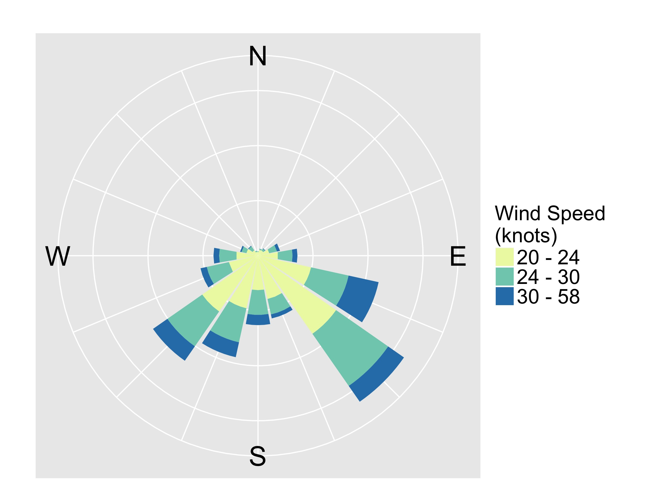
But the situation changes if we look only at winds from likely drifting events (> 20 kts):
SE / ESE

Slide 9
Drifting winds come from the
SE or ESE, not the SSW.
The familiar wind rose shows prevailing winds at Summit to be from the SSW. However, this plot is dominated by mild winds that don’t contribute to drifting. The 20+ kt winds that cause significant drifting tend to come from the SE or ESE.
Can do: Orient structures and cargo to minimize drifting from SE or ESE.

Slide 10
Major points:
Drifting winds come from the ESE, not the SSW.
North winds frequency peaks in July (31 %) and Aug (25 %)
Periodic drifting winds and equipment-stressing temps occur through through winter season.

Slide 11
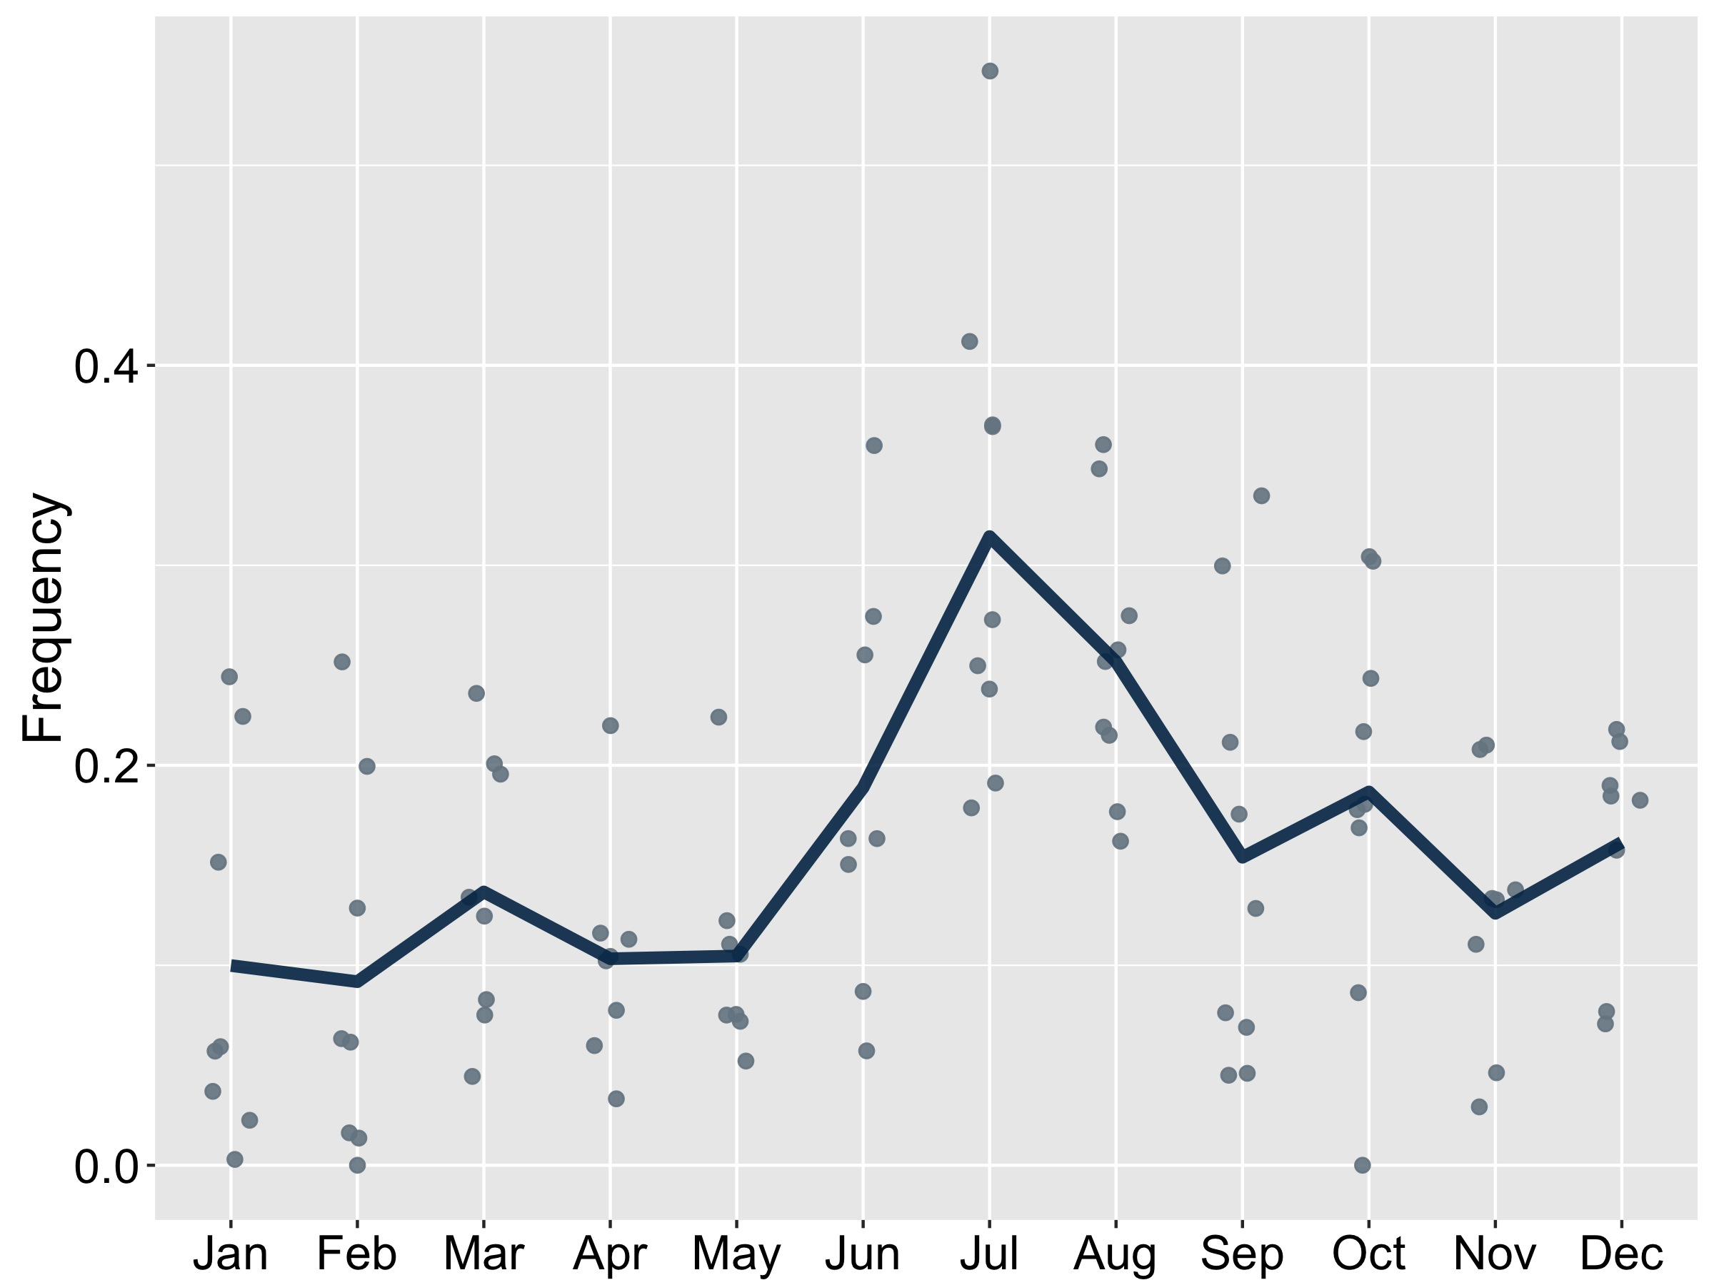
Frequency of North Winds by Month
Monthly mean
Dots show individual months of record.
Maximum is 0.54 in July 2015.
Wintertime minimum is 0.00.
May-Aug minimum is 0.05 in May 2013.
Average incidence increases from May to July, dipping in Aug.

Slide 12
How conservative do we need to be in our planning for north wind events?
Percentage of years in which this quoted north winds frequency is not exceeded
How to read highlighted box: In 80% of May - Aug summers, the frequency of north wind events has been < 0.30; in the other 20 %, the frequency has been > 0.30.

Slide 13
North winds frequency peaks in July (31 %) and Aug (25 %).
Can do: Anticipate mean ~30 % downtime for heavy equipment in summer season plans. North winds become more common in late summer; front-weight equipment activity for less disruption.

Slide 14
Major points:
Drifting winds come from the ESE, not the SSW.
North winds frequency peaks in July (31 %) and Aug (25 %)
Periodic drifting winds and equipment-stressing temps occur through through winter season.

Slide 15
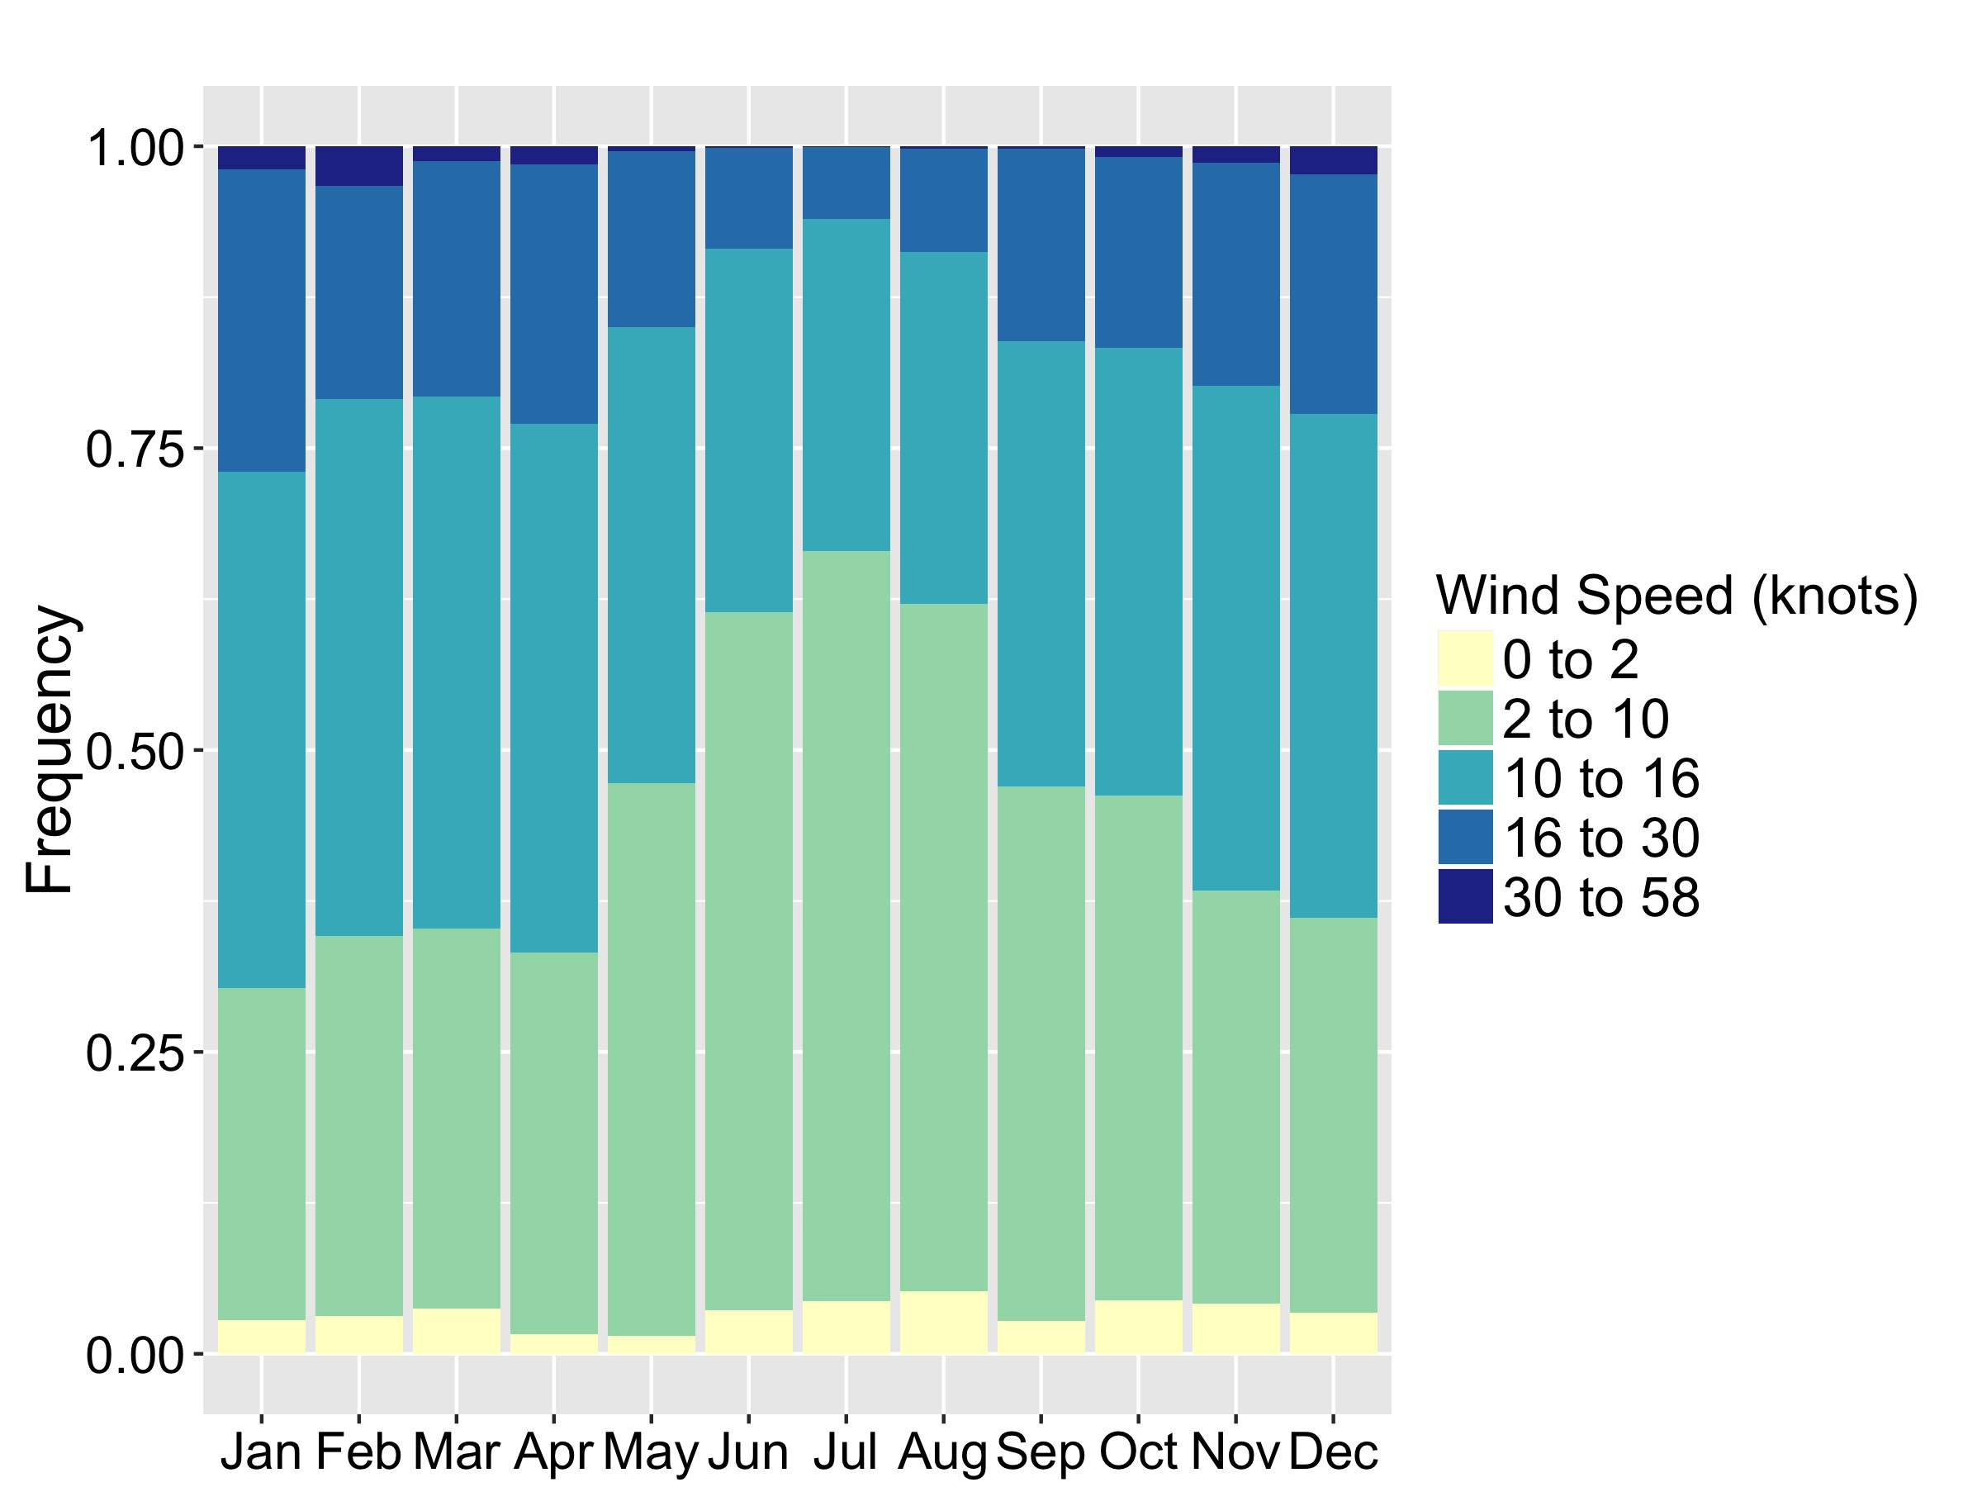
Frequency of Wind Speed Range by Month
Jan and Apr show largest fraction of
winds >16 knots, but by a small margin
Winds < 10 knots
most common
in summer

Slide 16
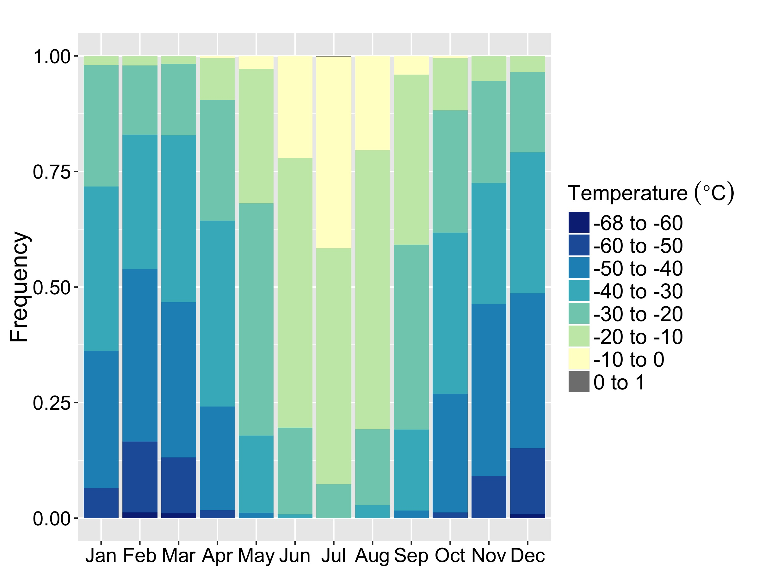
Frequency of Temperature Range by Month
January is relatively warm: due to frequent high winds.
Equipment-stressing temps below -50°C occur 12 % of time in Nov - Mar.

Slide 17
Periodic drifting winds and equipment-stressing temps occur through through winter season.
Annual weather pattern is largely as expected. While most winter month-to-month differences are small, Jan is relatively warm, likely from strong winds disrupting the temperature inversion.
Can do: Plan for drifting throughout the winter (11 % winds > 20 kts over Nov – Apr). Expect temperatures below -50°C to represent ~12 % of the Nov – Mar period.

Slide 18
Major points:
Drifting winds come from the ESE, not the SSW.
North winds frequency peaks in July (31 %) and Aug (25 %)
Periodic drifting winds and equipment-stressing temps occur through through winter season.

Slide 19
Ways we can respond:
Orient structures and cargo to minimize drifting from SE or ESE.
Anticipate mean ~30 % downtime for heavy equipment in summer season plans. North winds become more common in late summer; front-weight equipment activity for less disruption.
Plan for drifting throughout the winter
(11 % winds > 20 kts over Nov – Apr). Expect temperatures below -50°C to represent ~12 % of the Nov – Mar period.

Slide 20
Additional reference:
Statistical tables by
month and year

Slide 21
North Wind Incidence

Slide 22
Mean Temperature (°C)

Slide 23
Maximum Temperature (°C)

Slide 24
Minimum Temperature (°C)

Slide 25
Maximum Wind Speed (kts)

Slide 26
Mean Wind Speed (kts)

